Slide 1
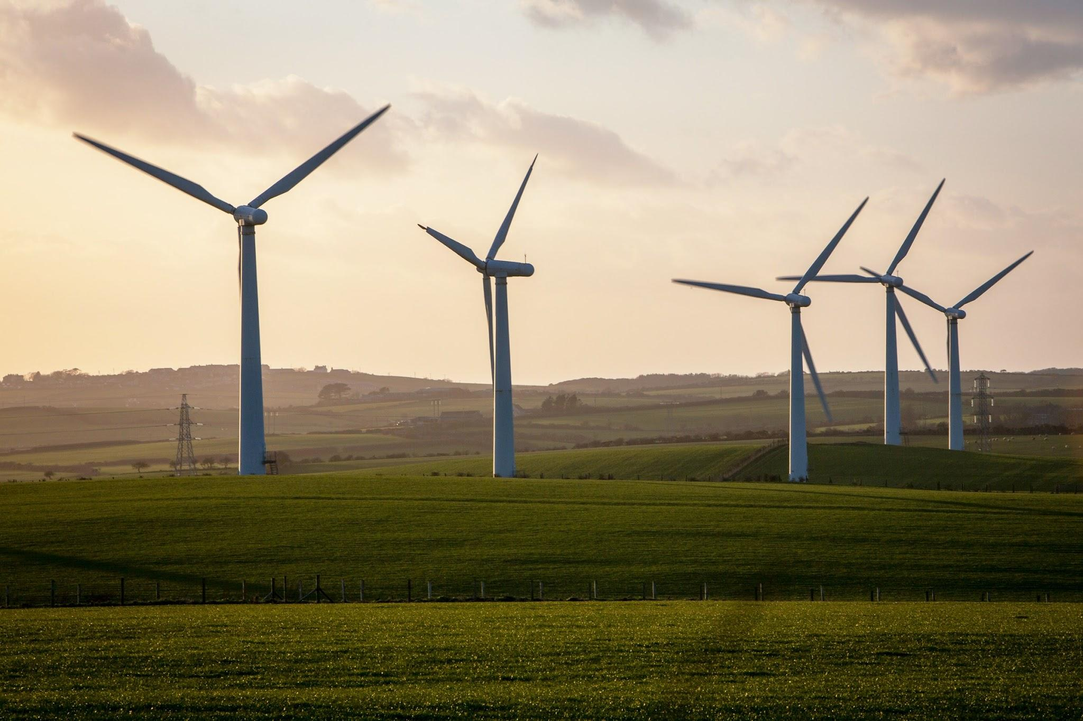
WIND ENERGY:
A great investment
opportunity for a better
future
Ashley, Batt, Raihan

Slide 2
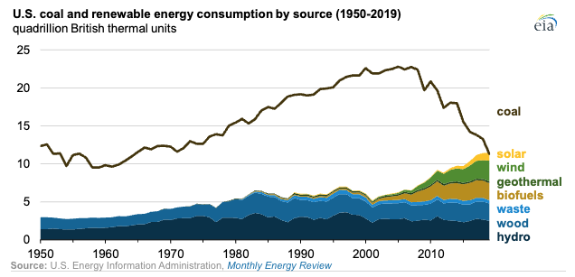
Comparison of Renewable Energy Market

Slide 3
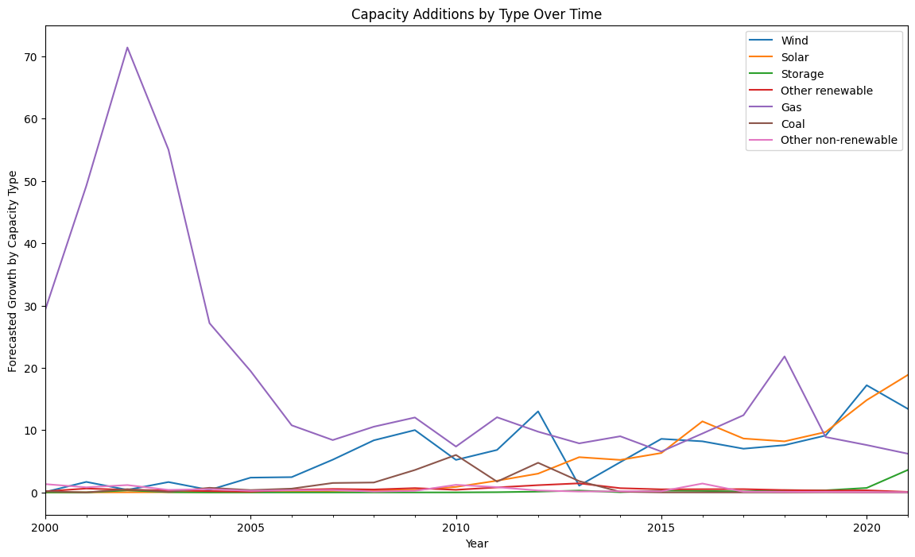
Additions in Gas Decline as Wind and Solar Rise.
Clearly Gas has been the Capacity Type which generated the highest Usage as well as Additions historically.
However, as we approach the latter years, a marked change occurs in 2019 where Gas, Wind and Solar meet. From then additions for Gas decline and the opposite occurs with Wind and Solar.

Slide 4
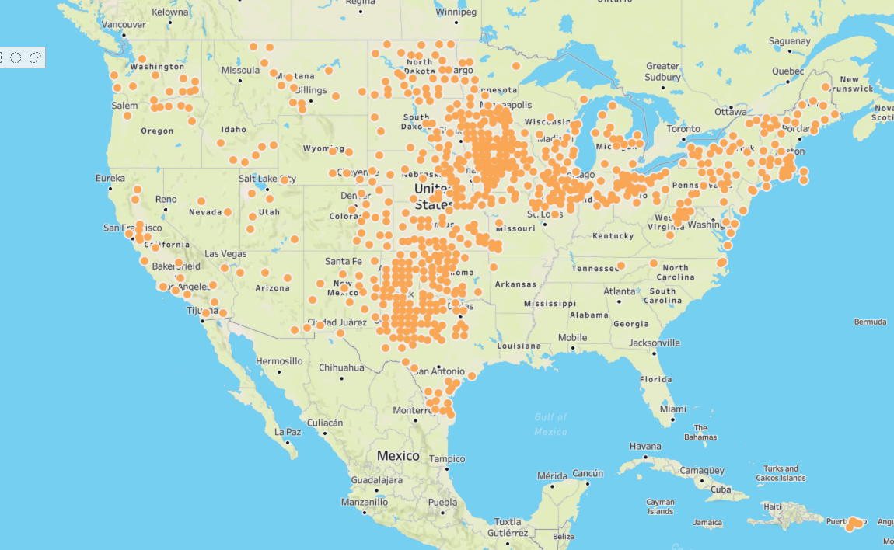
US Renewable Energy Market

Slide 5
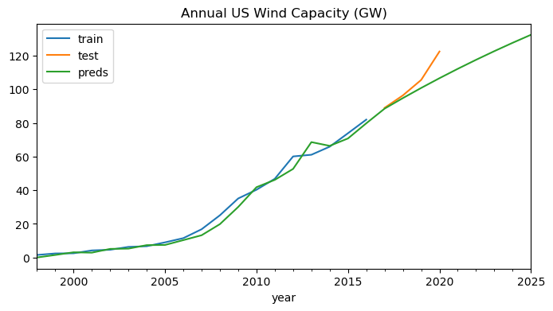
Annual Growth Projections

Slide 6
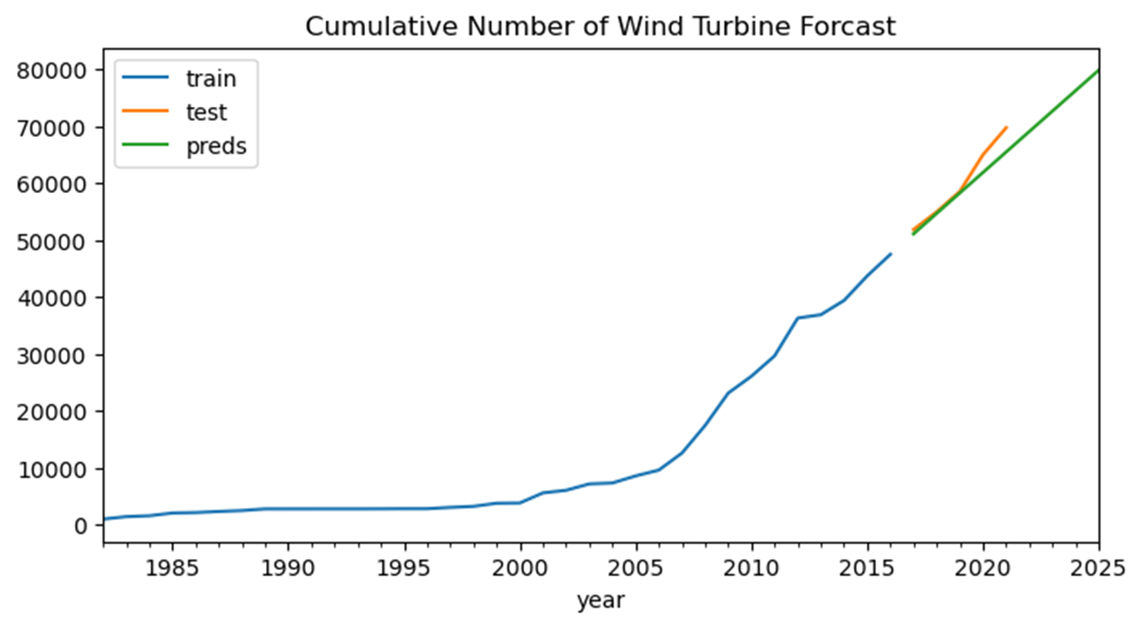
Annual Growth Projections

Slide 7
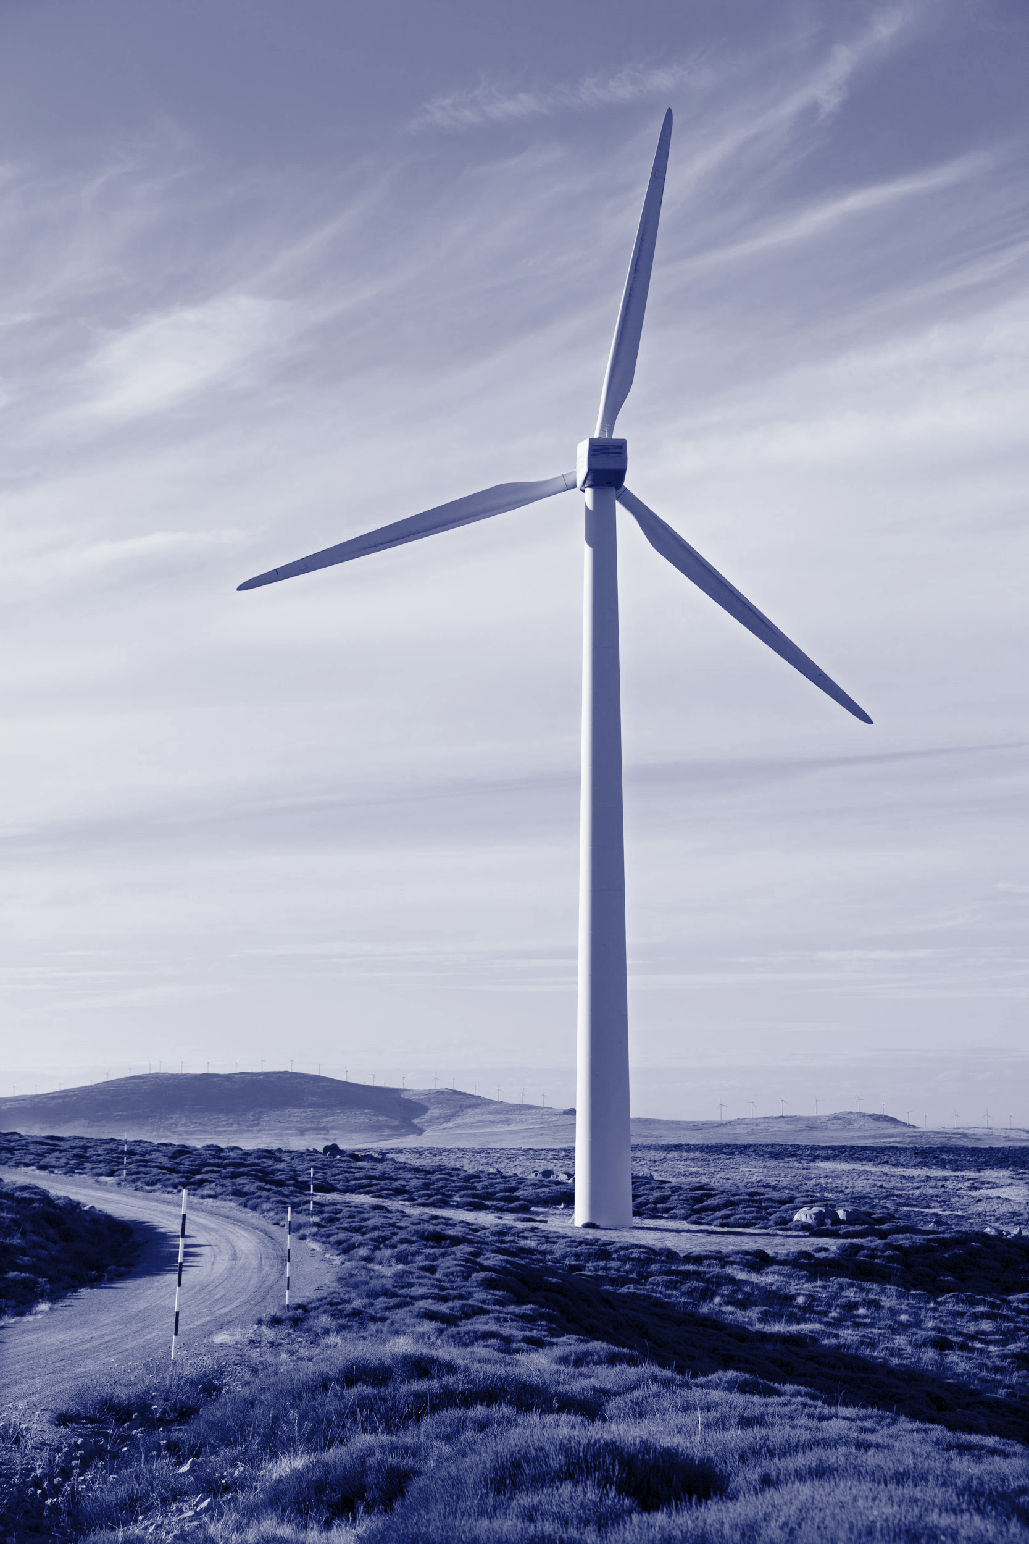
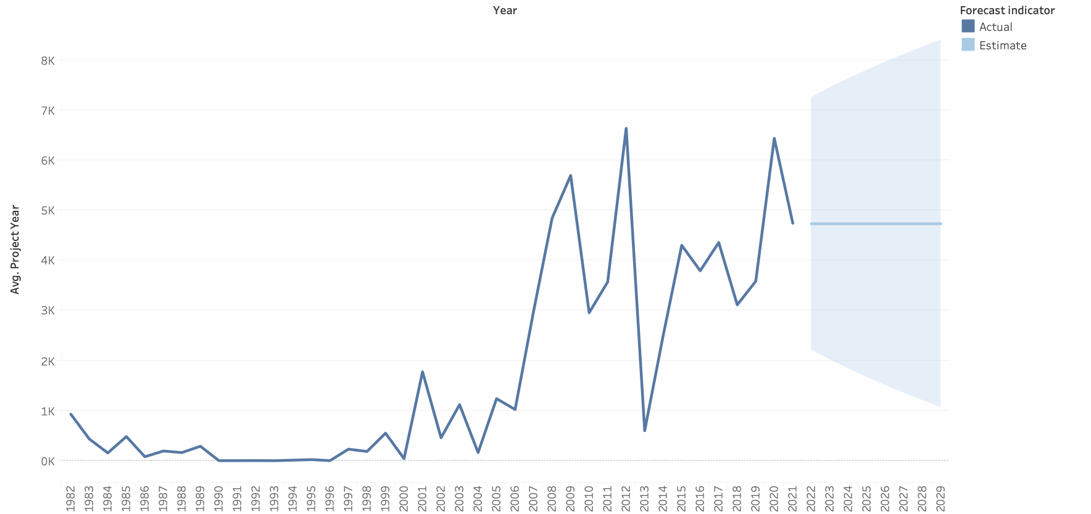
Near-term Head/Tail Wind

Slide 8
U.S. Offshore Wind Energy Market
May 2022, the U.S. offshore wind energy project development and operational pipeline grew to a potential generating capacity of 40,083 megawatts (MW).
The 40,083 MW in the U.S. offshore wind energy pipeline shows a 13.5% growth over the 35,324 MW reported in the “Offshore Wind Market Report: 2021 Edition
States policies aim to procure at least 39,322 MW of offshore wind energy capacity by 2040.
BOEM announces plan to develop WEA’s in up to seven U.S. regions by 2025
Seven new offshore WEA lease auctions including the New York Bight, Carolina Long Bay, Central Atlantic, Gulf of Maine, California, Oregon, and the Gulf of Mexico by 2025 (U.S. Department of the Interior 2021
BOEM held lease auctions for six new lease areas in the New York Bight and two lease areas in Carolina Long Bay..
As of May 31, 2022, 24 power purchase agreements1 for offshore wind energy procurement were signed in the United States.
State policies have resulted in 24 power purchase (offtake) agreements, adding up to 17,597 MW in offshore wind energy contracts. From the beginning of 2021 through May 31, 2022, 10 new power purchase agreements, totaling 11,874 MW, were signed

Slide 9
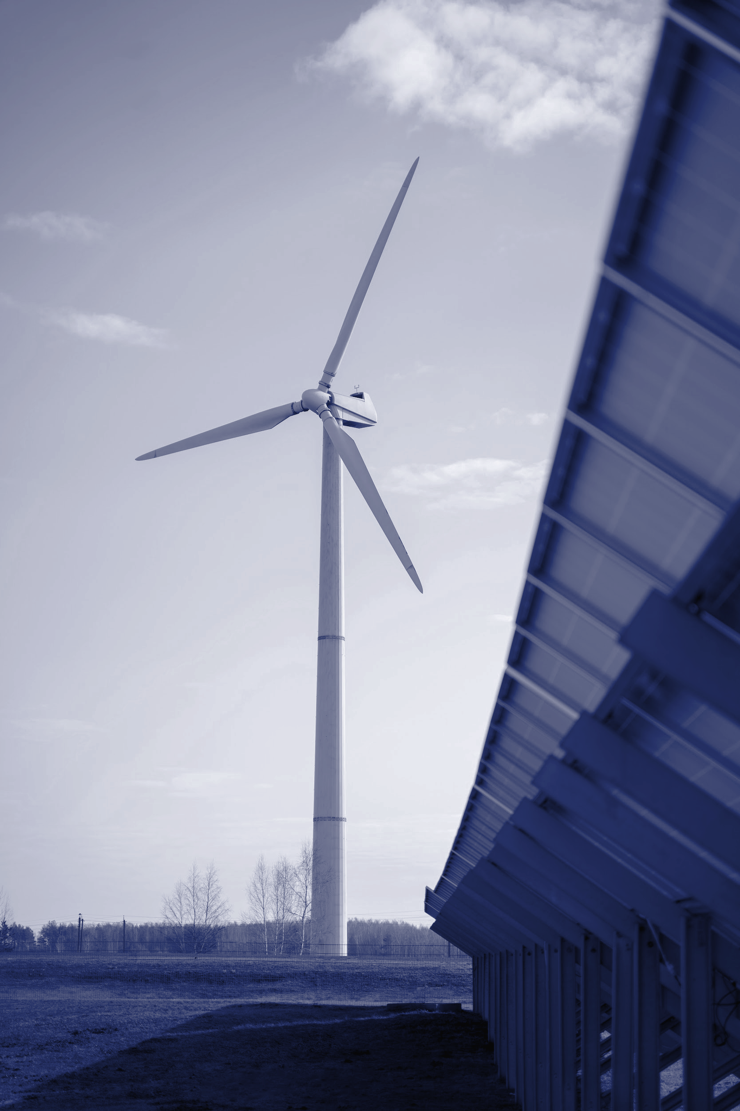
Wildlife Impacts of Wind Energy
Effects birds and bats
Speed of the blade are the cause
Mostly in West and East coast
Notes:
Thousands of birds and bats are killed annually by wind turbines. Causes of death include collision and barotrauma—internal injuries caused by exposure to rapid pressure changes near the trailing edges of moving blades. It is to estimates that between 140,000 and 500,000 bird deaths occur at wind farms each year and with some studies pinning fatalities at 888,000 bats a year.
Mostly california and wyoming

Slide 10
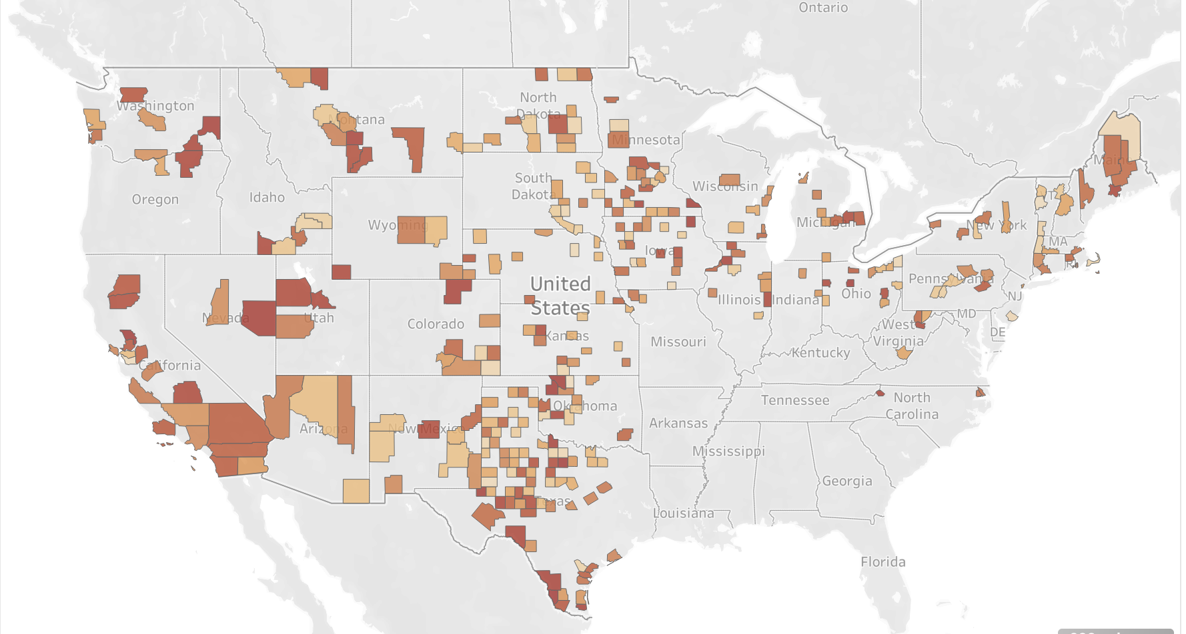
Turbine Count per County

Slide 11
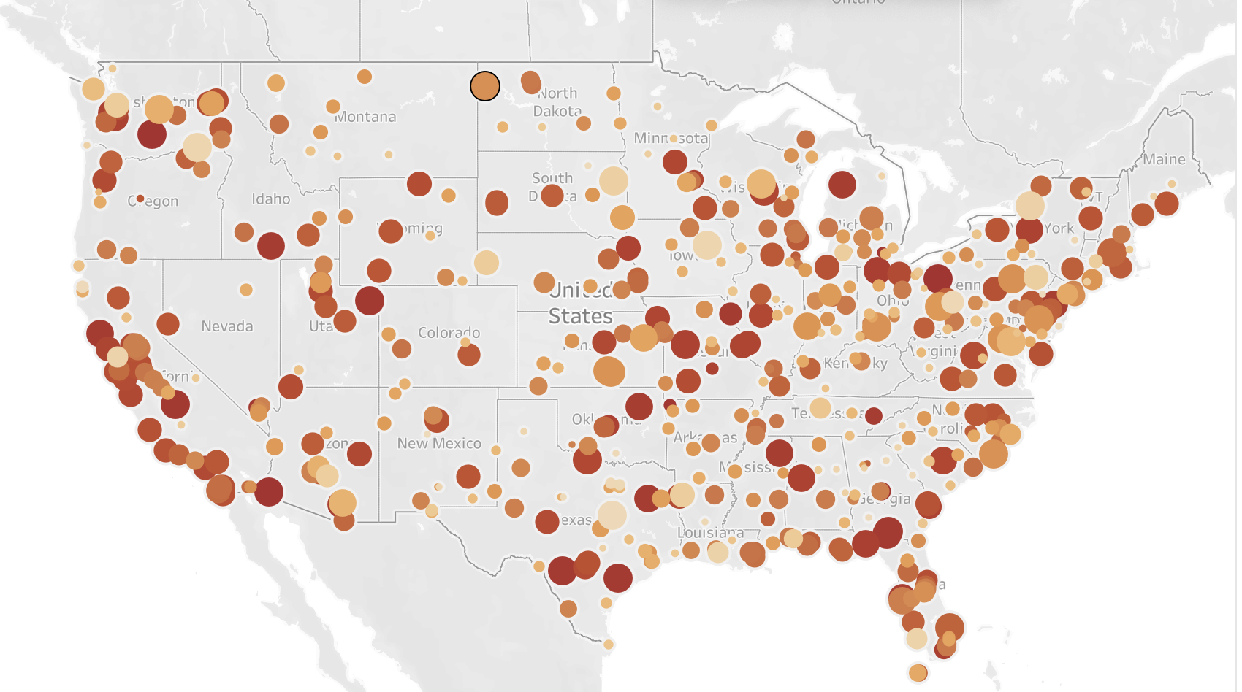
Airports in the US
Notes:
Wind turbines have a substantial impact on aviation and airspace. Turbines are significant physical structures that can penetrate volumes of airspace designed to be clear of obstacles.
Rotating turbine blades interfere with radar causing loss of target detection and may even result in incorrect target positions

Slide 12
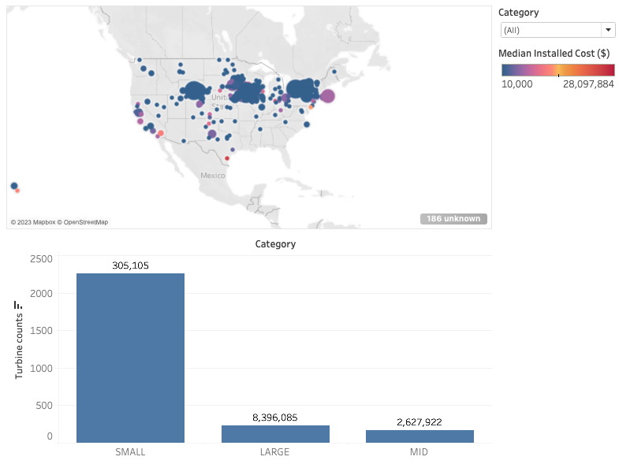
Recommendations
Wind Energy is recommended for investment
Predicted increase in wind capacity usage
A proliferation of new legislation
A Smaller facility is recommended
Cost Efficient
Three identifiable locations available
Presence of pre-existing infrastructure in areas already densely populated

Slide 13
Questions?

